Slide 1

Introduction to Customer Service
DYNAMICS 365

Slide 2

Mitch Milam
Dynamics CRM Architect
mitch@xrmcoaches.com
@mitchmilam
http://tinyurl.com/MitchMilamLinkedIn

Slide 3
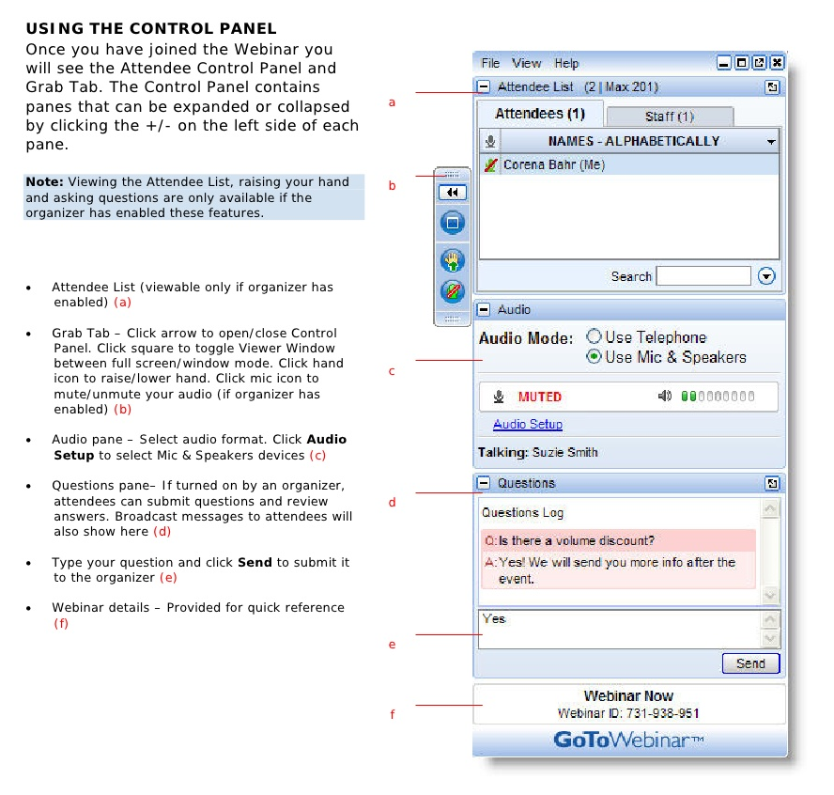
Webinar Housekeeping

Slide 4



2017 Training Roadmap
Webinars
http://www.xrmcoaches.com/webinars
KnowledgeBits
http://www.xrmcoaches.com/knowledgebits
Learning Plans
http://www.xrmcoaches.com/freestuff
More Goodies
Practice tests
On–Demand video training
Instructor–led training
Books

Slide 5
Agenda
What we are discussing
Queues
Cases
Case Creation Rules
Routing Rules
Subjects
Email Templates
What we are NOT discussing
Entitlements
SLAs
Knowledge Articles
Interactive Service Hub
Portals
Dashboards

Slide 6
Queues

Slide 7
Working with Queues
A queue is a container for ‘things’
A queue can be email-enabled

Slide 8
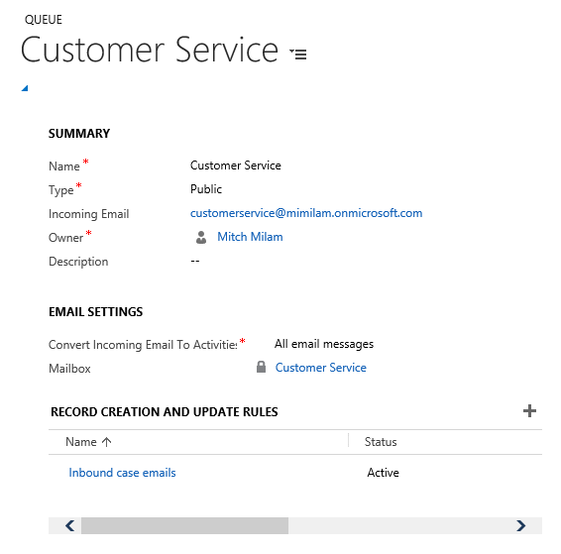
Queue Definition

Slide 9
Cases

Slide 10
What is an incident (case)?

Slide 11
An Incident Is
A failure in a:
System
Process
Product

Slide 12
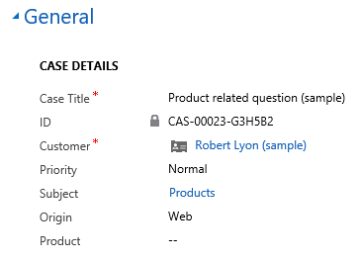
Case Details

Slide 13
Case Creation Rules

Slide 14
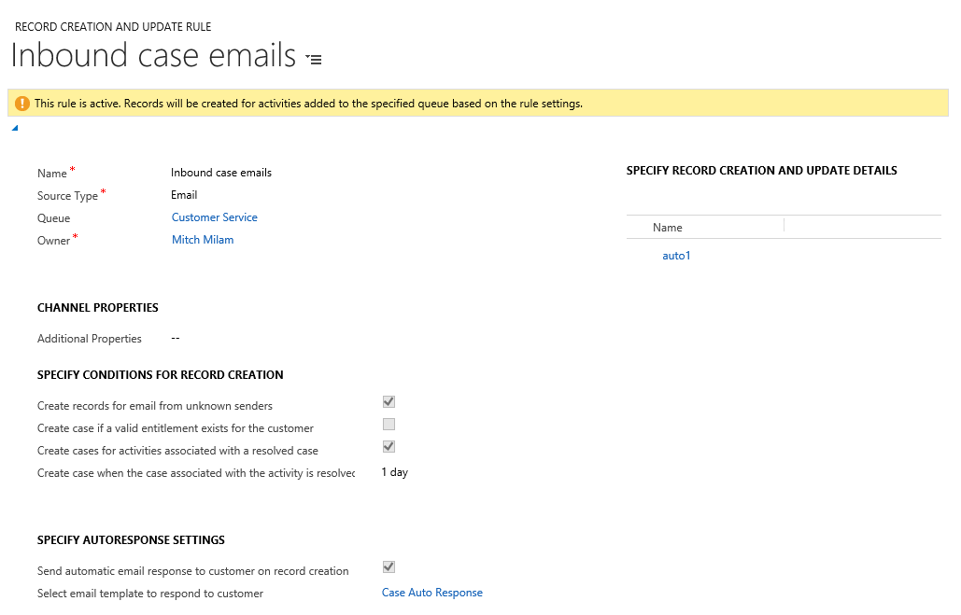
Rule Definition

Slide 15
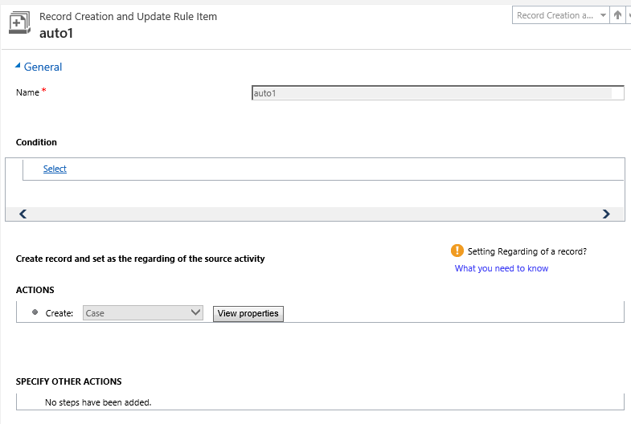
Rule Details

Slide 16
Routing Rules

Slide 17
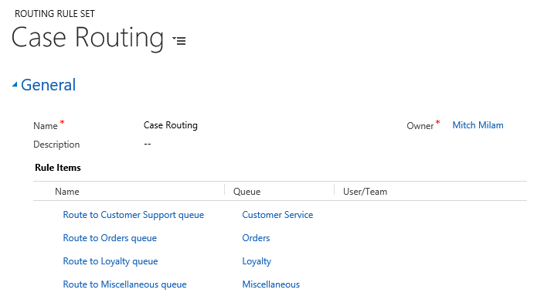
Routing Rule Definition

Slide 18
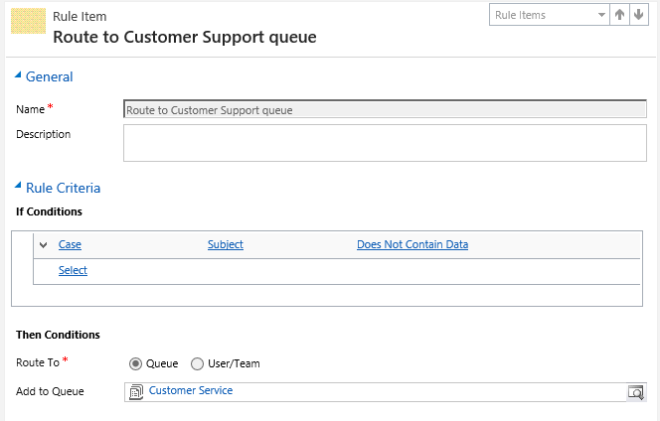
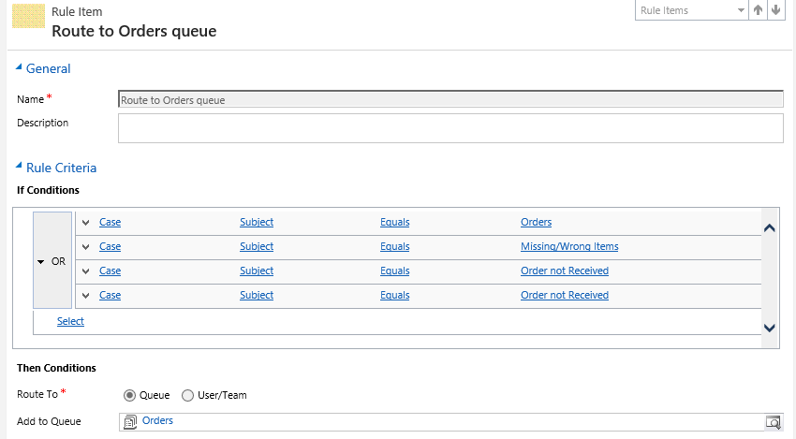

Slide 19
Subjects

Slide 20
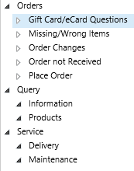
Subject Tree

Slide 21
Email Templates

Slide 22
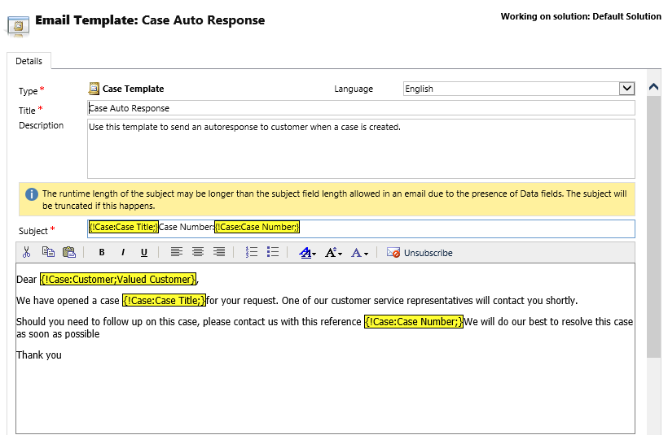
Email Template Definition

Slide 23
Dashboards

Slide 24
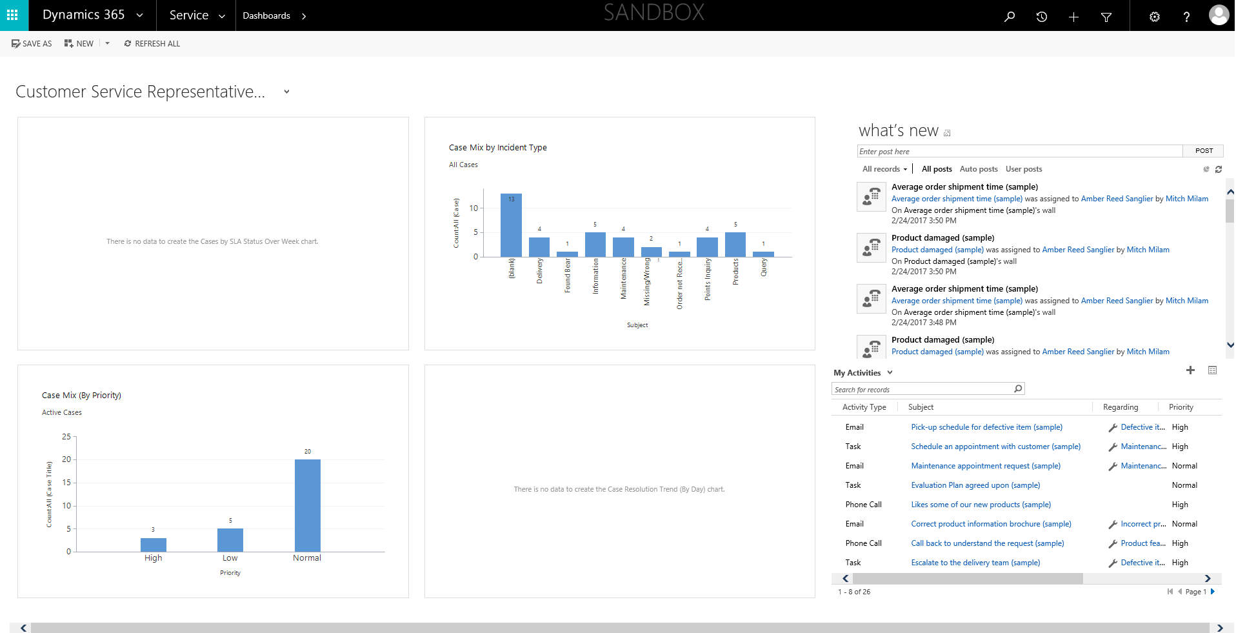
Customer Service Rep Dashboard

Slide 25
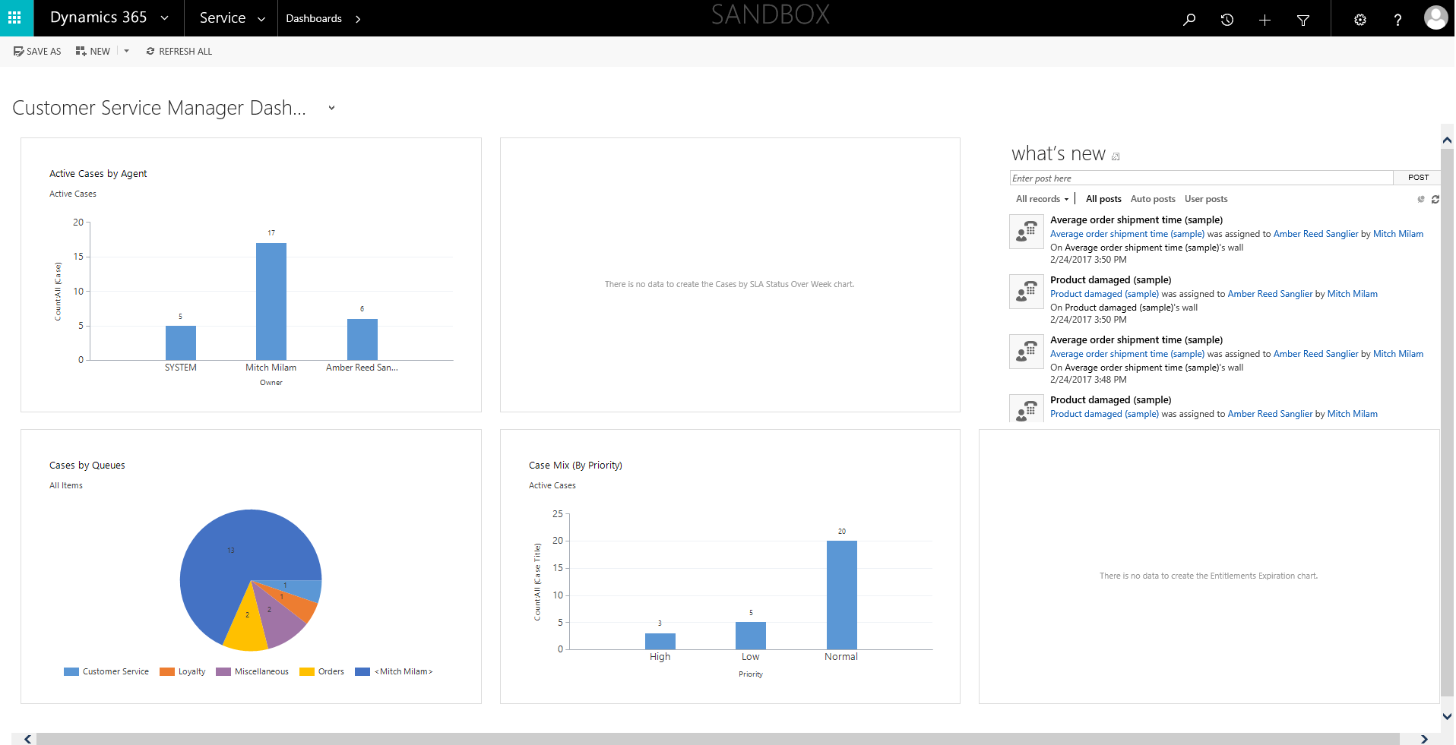
Customer Service Manager Dashboard

Slide 26
Questions?

Slide 27
Thank You

